Slide 1
CSE 3216 Microcontroller Based System Design Lab
Ms. Afsana Ahmed Munia
Ms. Fayza Amreen

Slide 2
CNC Machine
Submitted By:
Md Junaeid Bhuiyan 16.01.04.055
Amir Hossain 16.01.04.056
Afranul Haque Afran 16.01.04.059
Md Ruhul Amin Rakib 16.01.04.074

Slide 3
Introduction
This proposal outlines the planned construction of a Computer Numeric Control (CNC) type machine. The purpose of the project is to construct a functional CNC type machine capable of writing sentences in English on a two-dimensional object such as paper. The machine will be able to move on three axes and will be able to write with pen. The device would be capable of functioning independent of computer for both writing and determining writing paths. The goal is to keep balance between high precision and speed for functioning the device.

Slide 4
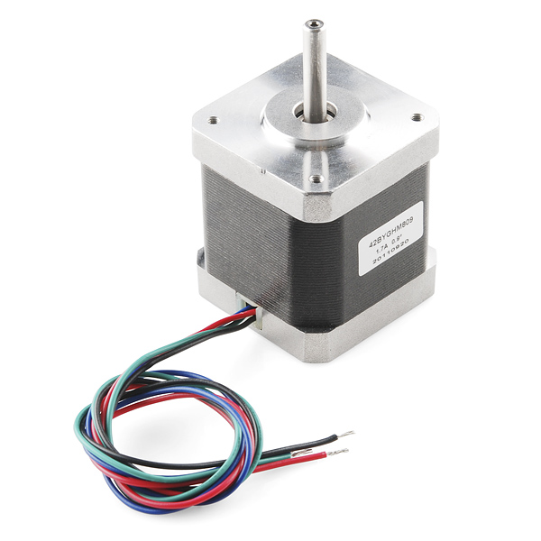
Equipment's
Stepper motor

Slide 5
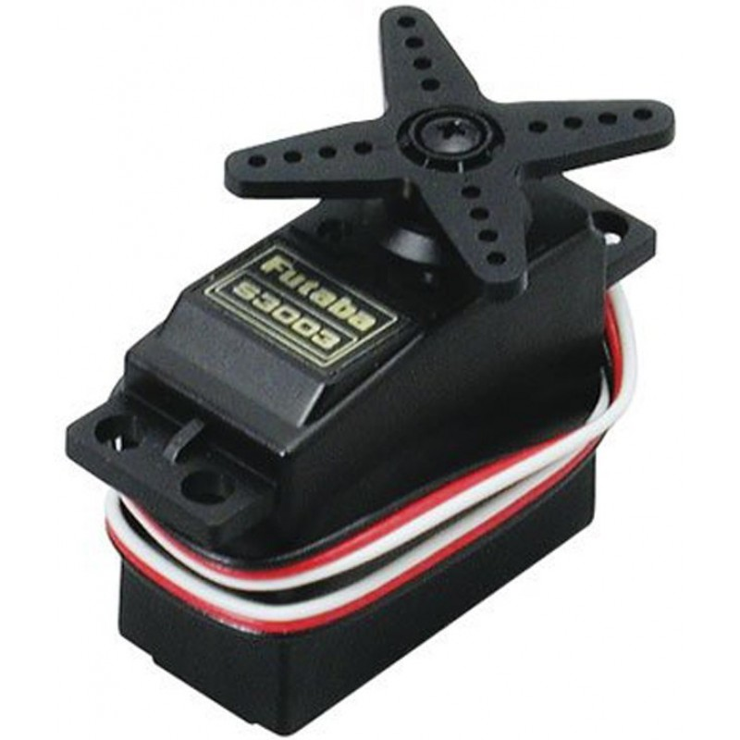
Equipment's
Servo motor

Slide 6
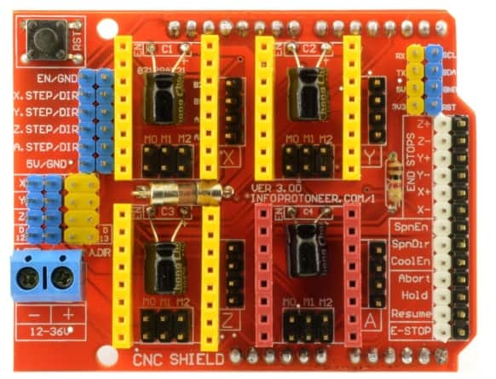
Equipment's
CNC Shield

Slide 7
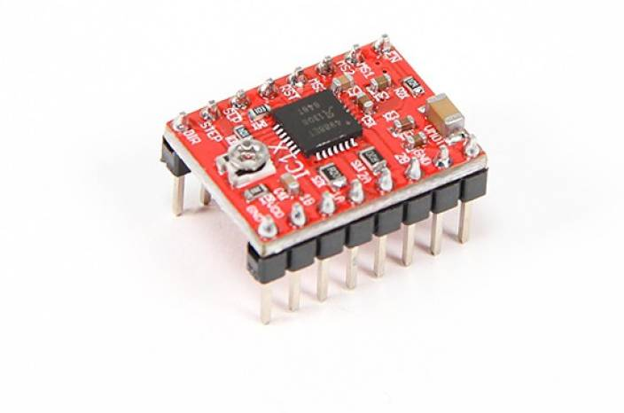
Equipment's
A4988 Driver

Slide 8
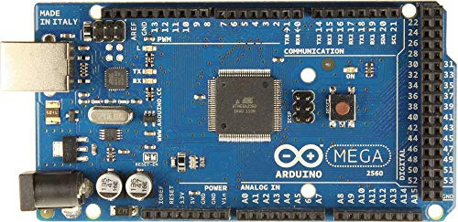
Equipment's
Arduino Mega 2560

Slide 9
Equipment's
Battery
Wires

Slide 10
Features
Device would be able to write anything in English.
Device will operate with high precision.
Device would be independent of computer for functioning.
Device would be dependent on computer for loading program into its microcontroller.
Device will be operated by a DC power source.

Slide 11
Thanks

